Slide 1
TypeScript
By: Rudhra Koul

Slide 2
Section -1 -:Introduction and Initial Setup

Slide 3
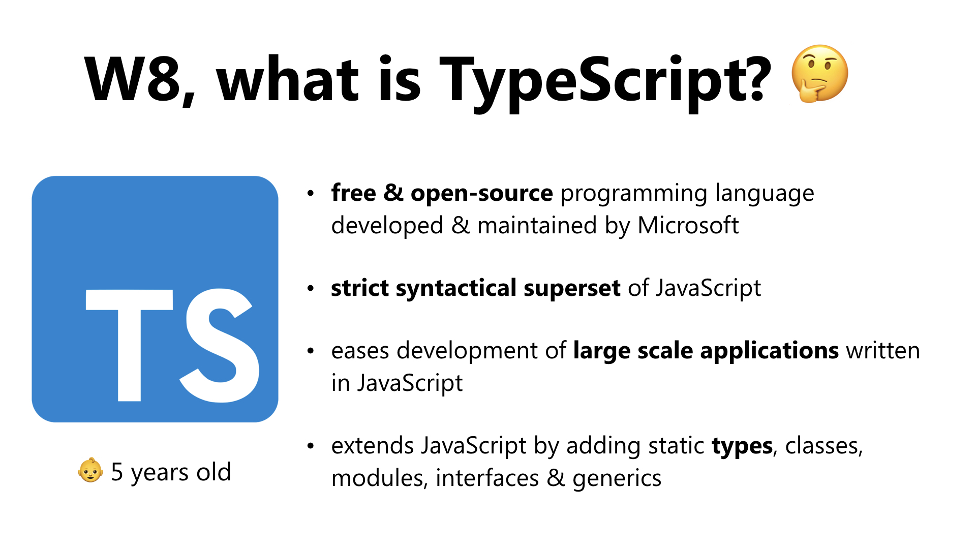
What and Why?

Slide 4
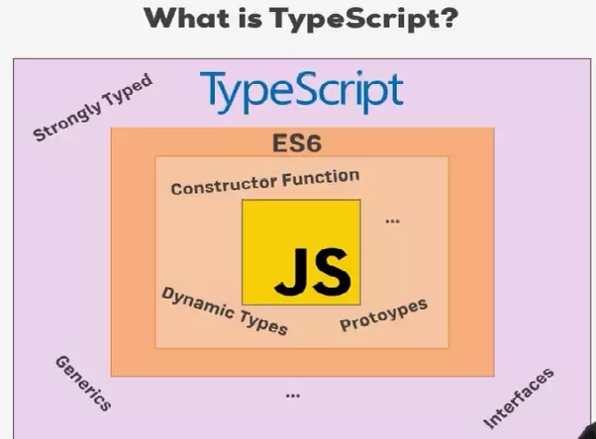
What and Why Cont.… ?

Slide 5
Important Links
Typescript-Official
Typescript-Playground
Nodejs-Download
Vs-Code Download
GitHub-Repository
TsConfigjson-Docs
TsConfig-CompilerOption-docs
TS-ES6-Comparison

Slide 6
Required Setup
Go to nodejs.org and download the latest version - uninstall (all) installed versions on your machine first. Install node-js the setup is fairly simple.
If you already have Node-js and just want to Update npm(node package manager):
npm install -g npm
Install type script:-
Open Node-js command prompt and type below command to install typescript using npm :
npm install -g typescript
Create a folder named typescript-complete-course
Create two files in this folder index.html and app.ts.
Install vs code and open the folder in vs code.
Open a new terminal in vs code by clicking terminal->new terminal or using the vscode shortcut ctrl+shift+`

Slide 7
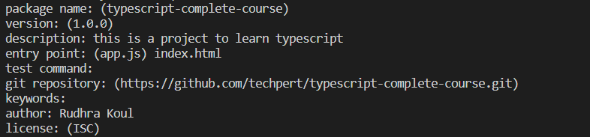
Required Setup cont…
Now lets put this project under the control of node js .This step is required if we want any further dependencies that our project might require to be handled by node.
In the command terminal write npm init
It will ask you a bunch of details which you can provide or else just type enter to accept the defaults. Below is the details I provided for the sample I will use for this training.
This command will create a new file with the name package.json which will contains all details that are needed by node(dependencies, test commands, run commands etc.) and also any dependencies that your project needs will be added here.
Now lets add a simple server that will serve our content on the web browser and will automatically re-render after re-compilation any changes that we do.
Run npm install lite-server --save-dev -:This commands installs lite-server as a devtime dependency using npm.It will add it as a development time dependency to our project by making an entry in the package.json file.We will also notice that it adds a new folder node_modules to our project that will have all the required dependencies.

Slide 8
Required Setup cont…
Now Open the package.json file and add following line to the scripts section.
"start": "lite-server“ :-This section contains the scripts that node runs when we run pm start command we are telling it to tart our little-server on startup.
Now we also want that all our typescript code gets compiled automatically to js and we don’t need to do it for every individual *.ts file. To do that we can also initialize the project with typescript.Run below command in the terminal :-
tsc --init :- This command initializes our project with the help of tsc(type script compiler) and saves its default settings in a file tsconfig.json which will be added to our project
It will ask you a bunch of details which you can provide or else just type enter to accept the defaults. Below is the details I provided for the sample I will use for this training.
To test run this project add a line console.log(‘it works’); to app.ts and add app.ts as a script in index.html by adding <script src="app.js"></script> in <Head> tag.
Open terminal and write npm start
This will open our browser typically n localhost:3000 if it is not busy or else will search a new port and render our project in the default browser on that port.
Now add some text to <body> of index.json we will see it gets updated on the browser and also we will notice our console.log on the console.We will also notice that our app.ts was compiled to app.js
The above project structure has been added to a github repository at following link address :
typescript-complete-course

Slide 9
Section -2 -:Using Types for a better Code

Slide 10
Basic-System-Defined-Types in Typescript
Javascript also has some types like String ,number etc. but we are not explicit about it whenever we create a variable we are not explicit about what type the variable could have should have or may have.
In type script we can be explicit .
Lets see using a demo using branch : type-check-comparison
So what types do we have lets take a look in demo using branch : Basic-System-Defined-Types
Now lets try to understand how it was converted to js in file basicSystemDefinedTypes.js
Now that we have a fair understanding of the basic types lets see some advanced types in a demo using branch : Advanced-Types

Slide 11
Section -3 -:Type Script Compiler

Slide 12
Type Script Compiler : TSC
In this section we will look into multiple tsc options
noEmitOnError:-
Consider an example where we declare a string variable :
let myName: string =‘rudhra’;
myName=20;
This code would give an error as number cant be assigned to a string but if we try to compile the ts file using tsc we would notice it does generate a js file.
This means that the compiler by default only gives a warning.If we want to change this behaviour we can set a compiler option in tsconfig.json "noEmitOnError": true
sourceMap
We already know that we can debug js files in browser but what if we want to debug ts files directly we can do so by setting “sourceMap”:true .This creates an additional file with extension *.js.map which makes our ts files visble in sources in developer options in chrome and we can debug them.

Slide 13
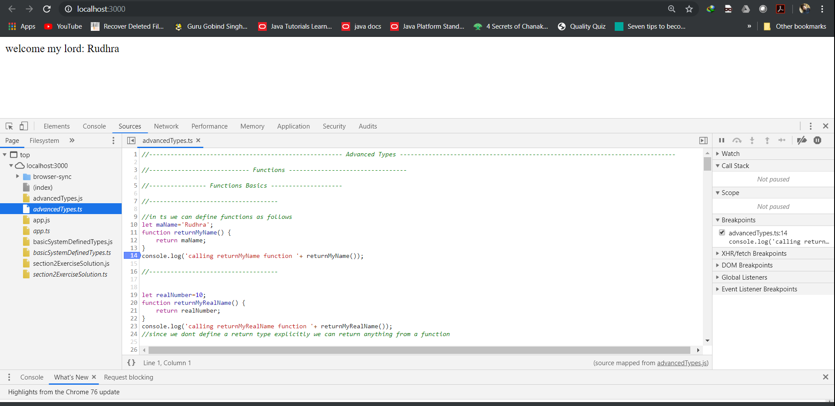
Debugging with sourceMap option in chrome

Slide 14
Type Script Compiler : TSC
noImplicitAny:-
Consider an example where we declare a variable :
let myName;
myName=20;
myName=“rudhra”;
This code would compile fine as ts would implicitly assign it as any,we can change this behaviour using the compiler option noImplicitAny.We can still explicitly set a variable to type any.
target
Specify ECMAScript target version: 'ES3' (default), 'ES5', 'ES2015', 'ES2016', 'ES2017', 'ES2018', 'ES2019' or 'ESNEXT‘
strictNullChecks
Consider the following function:
function controlMe(isTrue: Boolean) {
let result: number;
if(isTrue) {
result =12;
}
return result
}
The above function compiles fine but has an issue if isTrue is set to false result would be null.To make compiler
check this we can use strictNullChecks true option.

Slide 15
Type Script Compiler : TSC
noUnusedParameters :-
Consider the following function:
function controlMe(isTrue: Boolean, isAvailable:Boolean) {
let result: number;
if(isTrue) {
result =12;
}
return result
}
The above function compiles fine but has an issue it has an unused parameter isAvailable .To make compiler check this we can use noUnusedParameters true option.
We can specify any of the available compiler options as an input to tsc command using – in front of it. There are a lot of other options in tsconfig.json. Please refer to the official documentation(Links given on slide 5) for more info.
Demo branch : Typescript-compiler-options

Slide 16
Section -3 -:Type Script and ES6

Slide 17
Typescript and ES6
Typescript allows us to use some of the features of ES6 and the underlying code is converted to ES5 so all browsers support it.
TypeScript does not support all features of ES6.
Below is a link to the comparison of what ts supports and what not :-
http://kangax.github.io/compat-table/es6/
Lets take a look on some of ES6 features using a demo in branch :typescript-and-es6
We also have other ES6 features like symbols ,iterators, generators also supported by type script but they are beyond the scope of this training and should be covered in a dedicated ES6 course

Slide 18
Classes
Demo Using branch classes-basics

Slide 19
Thanks!!!!!

